Slide 1
WELCOME TO OUR PROJECT
AI BASED HOSPITAL CHAT BOT

Slide 2

SOUTHERN UNIVERSITY BANGLADESH
MASTERS OF SCIENCE IN COMPUTER SCIENCE AND INFORMATION TECHNOLOGY
AI BASED HOSPITAL CHAT BOT

Slide 3
SOUTHERN UNIVERSITY BANGLADESH
MASTERS OF SCIENCE IN COMPUTER SCIENCE AND INFORMATION TECHNOLOGY
Submitted By
Name
ID:

Slide 4
Supervisor
Supervisor name
Designation
Co-Supervisor name
Designation
Submitted To
DEPARTMENT OF COMPUTER SCINECE AND ENGINEEERING
SOUTHERN UNIVERSITY BANGLADESH

Slide 5
PRESENTAION OUTLINE
Abstract
Introduction
Motivation
Objectives
Literature Review
Methodology
Use Case Design
Block Diagram
Flow chart
Data Flow Diagram
Activity Diagram
Design and Implementation
Result
Conclusion
Reference

Slide 6
ABSTRACT
Artificial Intelligence has core branches like, Machine Learning which takes in data, searches patterns, improves itself using the data, and displays the outcome. To lead healthy lifestyle healthcare is very much important. In few unsocialized areas, it is quite hard to find a consultation with a doctor that easily regarding health issues. The main idea here is to make a healthcare chatbot based on Artificial Intelligence using NLP that can diagnose the disease and provide required details about the specific disease before consulting or visiting a doctor. Reduces the healthcare costs and improves accessibility to this medical chatbot. Specific chatbots act as virtual medical assistance, which helps the patient know more about their disease and helps to improve their health. The user can achieve the real benefit of a chatbot only when it can diagnose all kinds of diseases and provide the necessary information. A text-to-text medical chatbot involves patients in online conversation considering their health problems which provides a set of personalized diagnoses based on their provided symptoms. These bots connect with the potential patients visiting the site, helping them discover specialists, booking appointments, and getting them access to correct treatment.

Slide 7
INTRODUCTION
The Current artificial intelligence has developed to a point where programs can learn by the humans and effectively simplistic human conversations which is essential. One of the best-known examples of chatbots in recent history is Siri the AI assistant that is part of Apple's standard software for its products. Siri took chatbot mainstream in 2011. Since then, brands in every sector have started to use them, eventually developing a new trend conversational in user experience. This refers to an end-user experience in which your interaction with a firm or service is automated based on user prior behavior. If users are developing artificial intelligence applications like Alexa, which enables the use of voice to control devices. If you are a user, you can already interact with this Artificial Intelligence chatbot on popular messaging platforms like Facebook, Instagram and so on.

Slide 8
OBJECTIVES
To design and development an hospital AI chat bot application
User login and signup
Chat bot question and answer sheet

Slide 9
LITERATURE REVIEW
The literature review plays an important role in understanding the artificial intelligence domain and implementation of the working system. We have included three literature survey papers with proper explanations. Detection of cancer at an early stage helps to cure the disease and save the patient’s life. Most of the people detect the cancer at the last stage. Cancer is a disease which causes due to lasting growth, and spread of abnormal cells. Cancer patients lose hope to live longer and healthier lives. Depression is expeditiously becoming one of the difficult phases in the health sector. In this paper, communication helps a lot to improve one’s mental health, this problem gets solved partially if the patient tries to open up to someone, but nobody is available at right time. This is the reason where chatbot comes into limelight. NLP is used in making of this chatbot which is an important component of artificial intelligence, so we can imbibe same thing in our chatbot for generation of accurate and responsive answers with respect to given queries. This project creates the lucidity in the public data distribution system as the workload becomes faster. The profit to an integrated GPU unit is that it is cheaper which in turn means a less costly computer device. Integrated graphic cards such as Intel, Ryzen also produce less heat and use drastically less power. However, there is no proper security system such as biometric system.

Slide 10
METHODOLOGY
A software development methodology or system development methodology in software engineering is a framework that is used to structure, plan, and control the process of developing an information system or Application
Waterfall development method
Many consider the waterfall method to be the most traditional software development method. The waterfall method is a rigid linear model that consists of sequential phases (requirements, design, implementation, verification, maintenance) focusing on distinct goals. Each phase must be 100% complete before the next phase can start. There’s usually no process for going back to modify the project or direction.

Slide 11
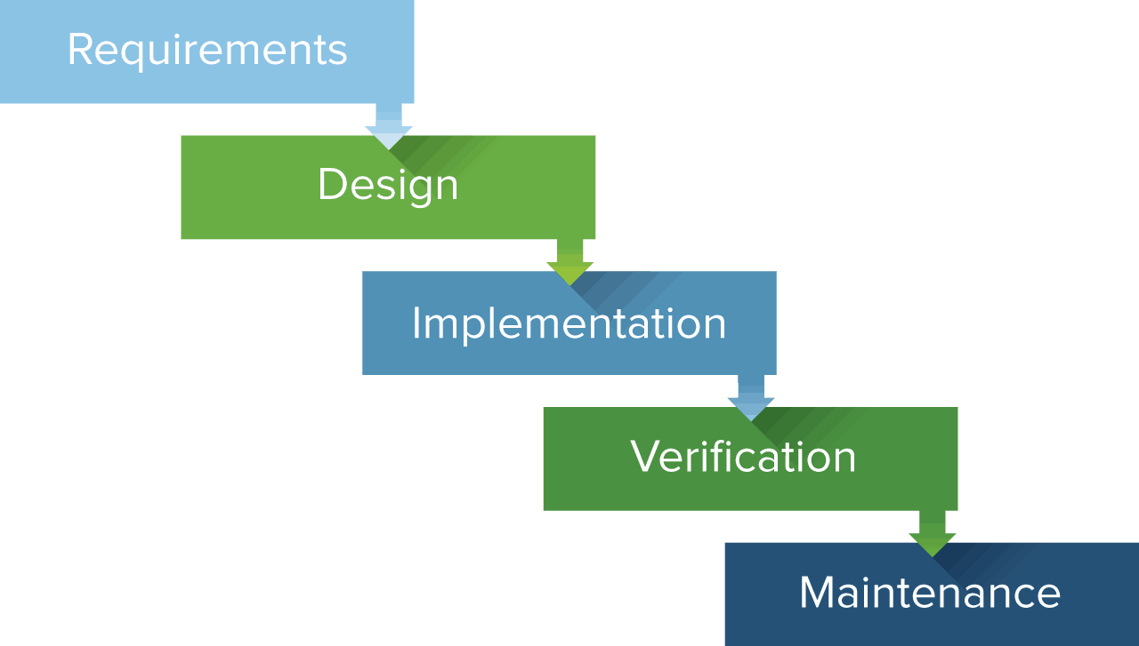
METHODOLOGY

Slide 12
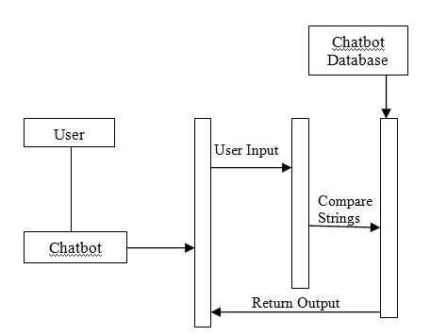
USE CASE DIAGRAM

Slide 13
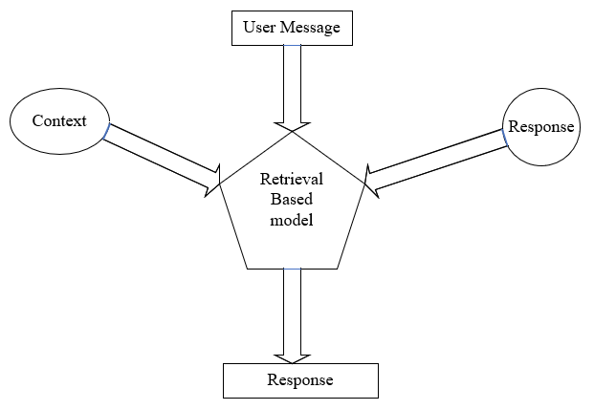
BLOCK DIAGRAM

Slide 14
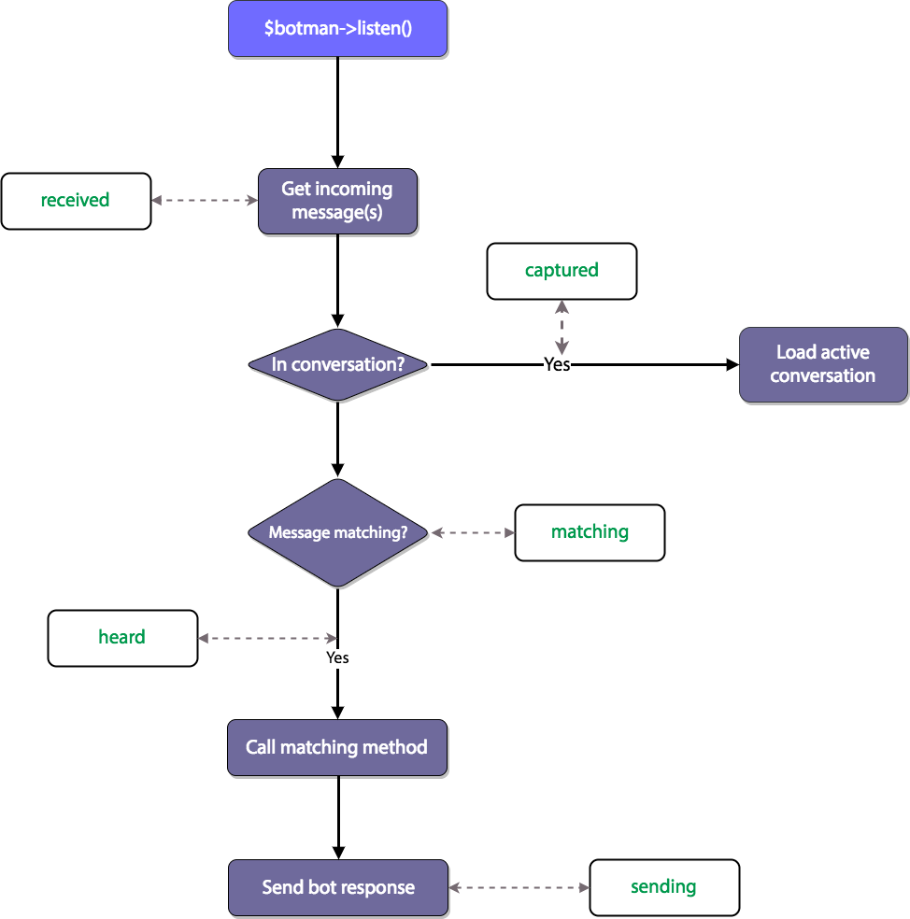
FLOW CHART

Slide 15
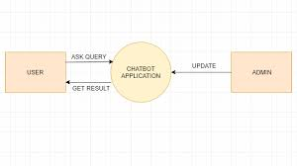
DATA FLOW DIAGRAM

Slide 16
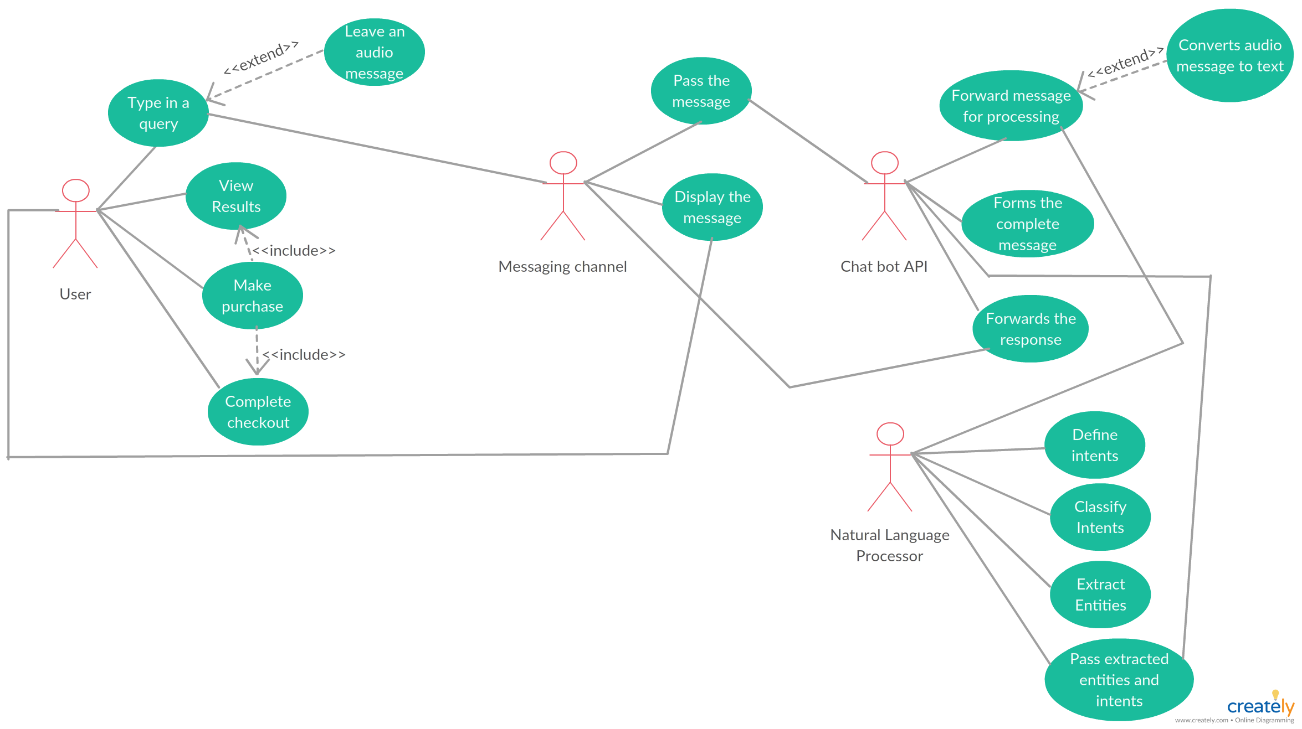
USER ACTIVITY DIAGRAM

Slide 17
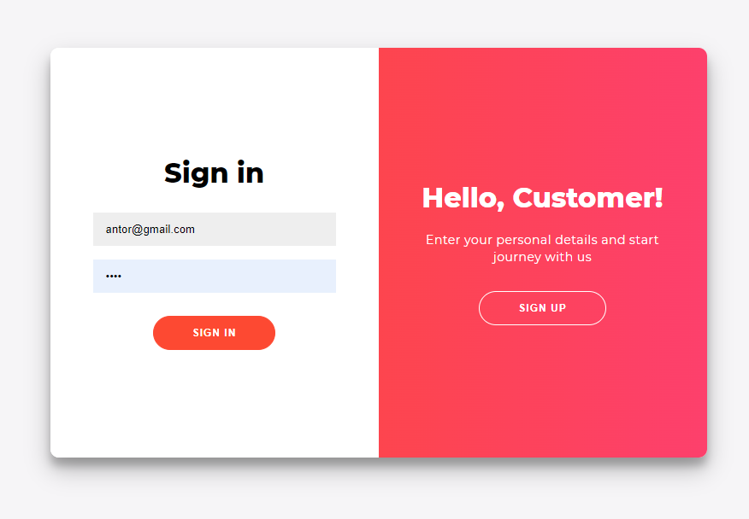
DESIGN AND IMPLEMENTATION
LOGIN PAGE

Slide 18
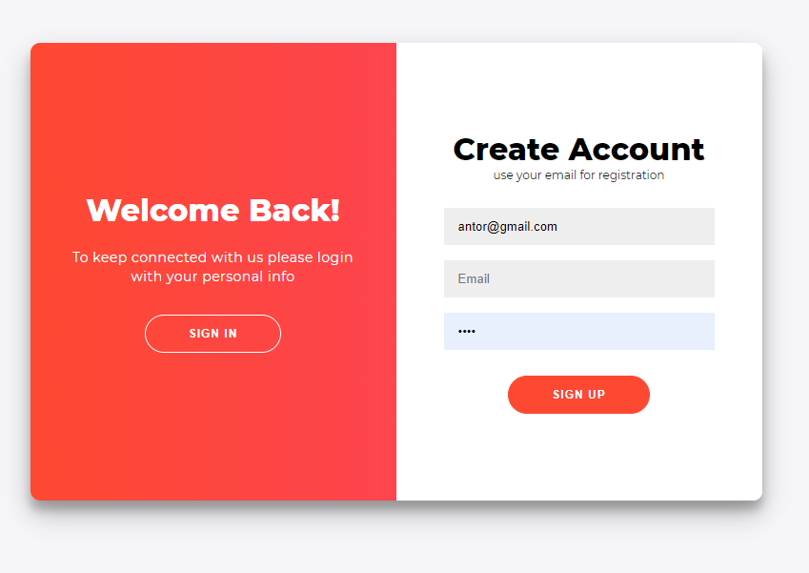
DESIGN AND IMPLEMENTATION
SIGNUP PAGE

Slide 19
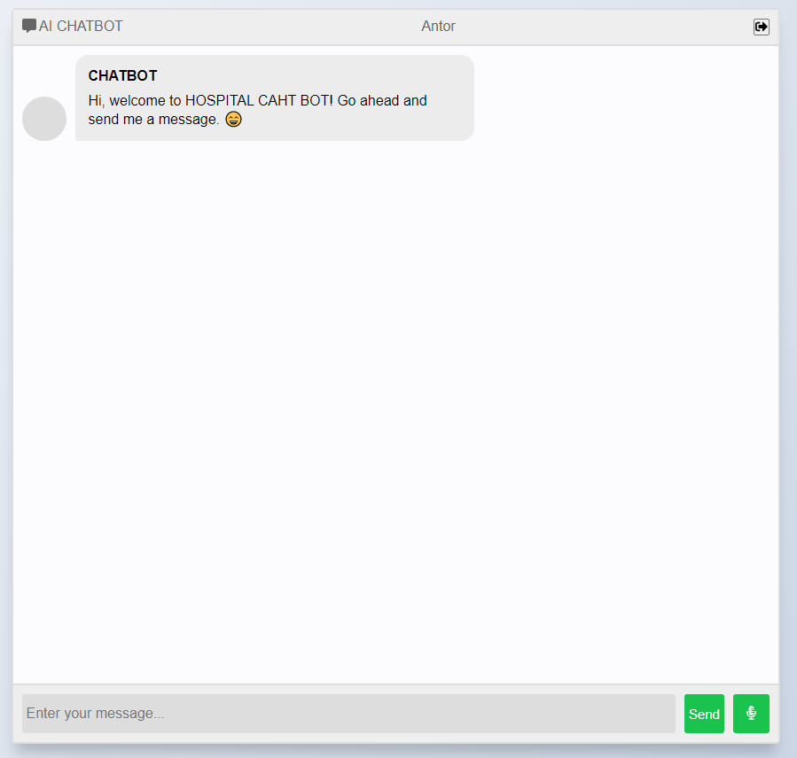
DESIGN AND IMPLEMENTATION
HOSPITAL CHAT BOT

Slide 20
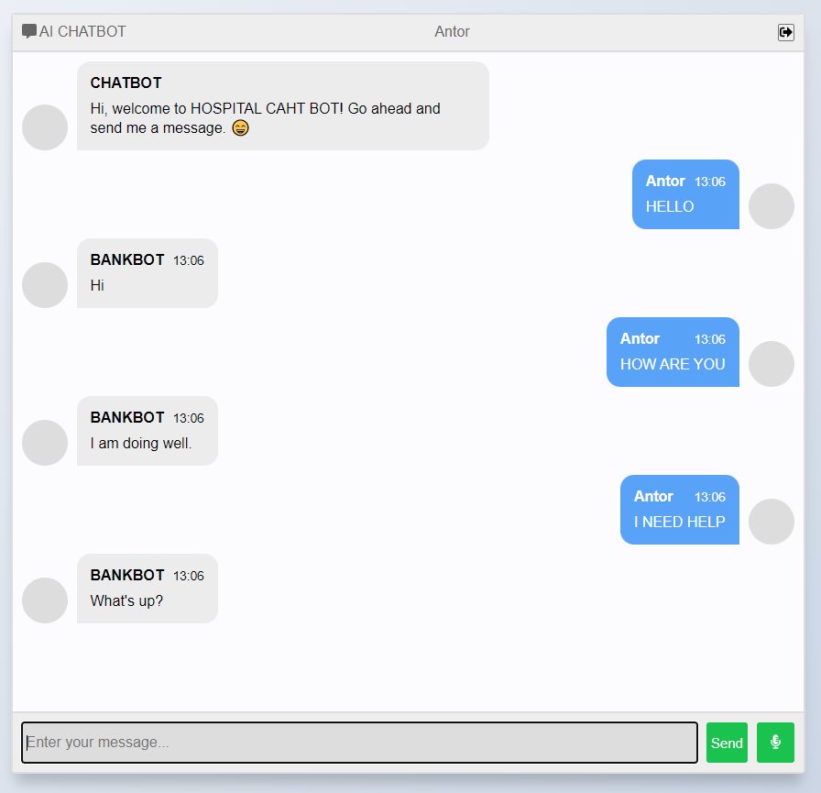
RESULT
HOSPITAL CHAT BOT CONVERSATION

Slide 21
CONCLUSION
The main aim of the project AI Based Healthcare chatbot system using Natural Language Processing, which is easy to use and more secure than the current system it will cure the diseases and helps to maintain proper health in the current system. This system reduces the possibility of diseases. The information is processed and store in the database, then it is reverted to the user. Also, it provides an accurate information about the heath symptoms and medicines to the patients. The government will also keep the track of the medicines supplied to the medicals and hospitals. By using diagnosis software, the results are generated accurate and fast. For end users it became easy to gain access in healthcare website and explore different types of services. After using such web-based applications, the results of healthcare were affected in different countries and rate of mortality was steadily decreased. With the help of this natural language processing the proposed system can help the government organizations and hospitals also help in the development of the country. Thus, we successfully build up a system for hospitals and medical institute so that user can ask their queries with the medical assistant and book the doctor’s appointment by giving text messages.

Slide 22
FUTURE PLAN
Future scope of the project could be ML Based Healthcare chatbot system using NLP can also include a mobile assistant in it which will be more functions will be added and can be accessed by many users. Which will also reduce the time and will also be accurate in the health details of patients given to the doctors. We can add biometric system for more secure authentication process.

Slide 23
REFFERENCE
[1] "Real World Smart Chatbot for Customer Care using a Software as a Service (SaaS) Architecture “Godson Michael D’silva1”, Sanket Thakare2, Shraddha More Available: https://www.docme.ru/doc/2207164/i-smac.2017.8058261
[2] Divya Madhu, Neeraj Jain C. J, ElmySebastain, ShinoyShaji,AnandhuAjayakumar,” A Novel Approach for Medical Assistance Using Trained Chatbot”, International Conference 2016. Available: https://www.semanticscholar.org/paper/Anovelapproachformedicalassi stancusingMadhuJain/b9117a428a35aca643f83e6986ae2 00807cba5c7
[3] YerlanJ Saurav Kumar Mishra, Dhirendra Bharti, Nidhi Mishra,” Dr.Vdoc: A Medical Chatbot that Acts as a Virtual Doctor”, Journal of Medical Science and Technology Volume: 6, Issue 3, 2016. Available: http://medicaljournals.stmjournals.in/index.php/RRJoMST/article/view /30
[4] PavlidouMeropi, Antonis S. Billis, Nicolas D.Hasanagas, CharalambosBratsas, Ioannis Antoniou, Panagiotis D. Bamidis, ”Conditional Entropy Based Retrieval Model in Patient-Care Conversational Cases”,2017 IEEE 30th International conference on Computer-Based Medical System. Available:- https://ieeexplore.ieee.org/abstract/document/8104260
[5] Abbas SaliimiLokman, Jasni Mohamad Zain,FakultiSistemKomputer, KejuruteraanPerisian,” Designing a Chatbot for Diabetic Patients”, ACM Transactions on Management Information Systems (TMIS), Volume 4, Issue 2, August 2018. Available: http://ijircce.com/upload/2018/june/7_Pharmabot.pdf
[6] Nicolas D .Hasanagas, CharalambosBratsas, Ioannis Antoniou, Panagiotis D. Bamidis, ”Conditional Entropy Based Retrieval Model in Patient-Care Conversational Cases”,2017 IEEE 30th International conference on Computer-Based Medical System. Available: https://scholar.google.co.in/scholar?q=International+conference+on+C omputerBased+Medical+System.&hl=en&as_sdt=0&as_vis=1&oi=sch olart
[7] Kowatsch, T., VollanMobile Coach. In: Designingthe Digital Transformation. DESRIST 2017. Lecture Notes in Computer Science, vol 10243, pp. 485-489. Springer, Berlin; Germany (2017). Available: https://www.researchgate.net/publication/317181609_Design_and_Eva luation_of_a_Mobile_Chat_App_for_the_Open_Source_Behavioral_H ealth_Intervention_Platform_MobileCoach

Slide 24
THANK YOU

